Slide 1
Transitioning Out of Your Postdoc: A Toolkit
Objective: Explore how a postdoctoral scientist can transition to their desired career.
Target audience: Graduate students and postdoctoral fellows.

Slide 2
How to Navigate the Toolkit
Start with:
Explore career options
Build the skills and network you need for career advancement
Choose the next module to fit your career goals:
3. Advice for academic faculty careers
4. Advice for non-academic careers
Notes:
In presenting this toolkit, the presenter can choose what to show and discuss in detail depending on the interest of the audience.
As an individual user, you can skip section 3 or 4 if you want.

Slide 3
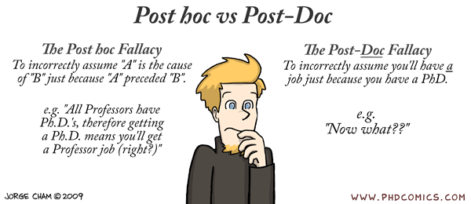
A Post-doc is a Temporary Position.
What’s Next?
Notes:
In a live presentation, the presenter can take some time here to introduce the concept that a postdoc is a stepping stone to multiple careers and to get to know the audience.

Slide 4
1. Considering Academic and Non-Academic Jobs
Think about career advancement as early as possible
Explore your career options
          Choose what best fits your interests, skills and values
What am I good at?
What do I like/not like
to do?
Talents
Skills
Passions
Interests
*
Values
What is important
in my life?
Notes:
Career exploration might be challenging for early-career researchers and career transitions may take a long time, so you have to start planning early.
You need to be aware that every sector/business has its own specific requirements, features and resources. You also need to decide what you would like to do and what fits with your values.
Here, we provide tips on how to look for opportunities and market yourself to prepare for a faculty position or your selected career path.

Slide 5
What are Employed PhDs Doing?
Of 787,000 employed scientists and engineers surveyed in 2015 in the USA, 41% were primarily doing Research and Development in:
government
31,000
3.9%
of total
academia
137,000
R&D
17.4% of total
private sector, for-profit
124,000
15.8% of total
Source: National Science Foundation, Survey of Doctorate Recipients, 2015
Notes:
The majority of PhD recipients in the US are employed outside of academia.

Slide 6
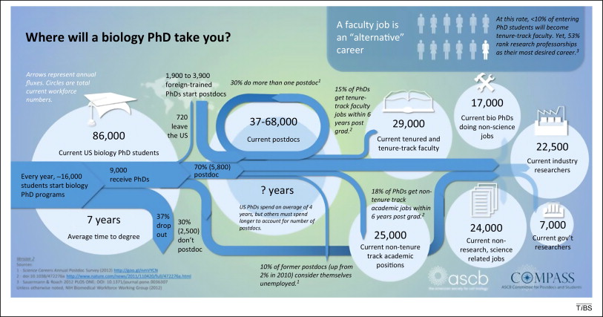
What are Employed PhDs Doing?
Trends in Biochemical Sciences 2014 39, 571-573DOI: (10.1016/j.tibs.2014.09.006)
Copyright © 2014 Elsevier Ltd Terms and Conditions
Notes:
Also, while you may stay in academia, tenure-track faculty jobs are a minority. There are a variety of career choices outside of research, performing jobs to aid in the scientific and biomedical enterprise.
30% of PhDs do more than one postdoc.
https://www.cell.com/trends/biochemical-sciences/fulltext/S0968-0004(14)00172-8

Slide 7
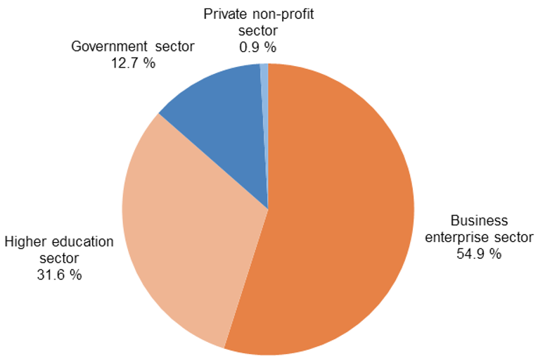
The R&D sector in the European Union
One-third of the employed population in EU work in knowledge-intensive businesses.
Notes:
Data on PhD employment are limited in the EU and other countries, but general information on R&D employees draws a similar picture. You may need to explore whether specific industries value doctoral and postdoctoral experience.
References
https://ec.europa.eu/eurostat/documents/3217494/9087772/KS-02-18-728-EN-N.pdf/3f01e3c4-1c01-4036-bd6a-814dec66c58c
https://ec.europa.eu/info/sites/info/files/srip-report-full_2018_en.pdf

Slide 8
To Consider for Career Advancement
What type of work do you want to do?
  Research, teaching, intellectual property, technology transfer, policy…
In what area/sector do you want to do this work?
  Academia, pharma, government, non-profit…
What is your professional brand – what area(s) of expertise do you want to be known for?
  Technical abilities, science writing, advocacy, outreach…
What do you have to offer in terms of expertise, skills, ability?
What additional skills do you need to develop to land your preferred job? Do you need to stay in the academic ladder or do you need to step outside that career path to gain them?
Notes:
To begin your career exploration you should start asking yourself several questions that will help you define what you would like to do.
Personal skill development will look different depending on the desired position.

Slide 9
Tools You Can Use to Begin Your
Career Exploration
Individual Development Plan (IDP)
Informational interviews (meetings with experts in different careers)
Career counselors/ University Trainee Office
Career fairs at conferences or university
Science Careers (from AAAS)
InterSECT (Job simulation website)
Internship programs in different companies and sectors
Notes:
You can start by defining what looks interesting to you then explore what the job would be like by speaking to professionals in the sector and recruiters.
There are multiple available online resources:
Expo events and career fairs, such as https://www.nature.com/naturecareers/career-expo
Science Careers, AAAS: http://www.sciencemag.org/careers/career-resources
InterSect: https://intersectjobsims.com/library/
Though you should develop a plan for your career be ready to think beyond your plan if unexpected career opportunities present themselves.

Slide 10
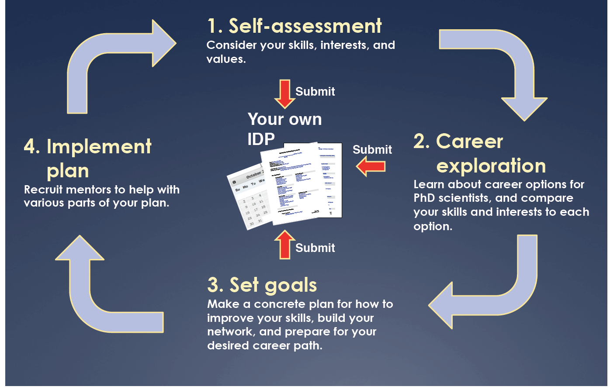
Individual Development Plan
http://myidp.sciencecareers.org
Notes:
Outline an individual professional development plan (IDP) early on in your postdoc and periodically revise it. http://myidp.sciencecareers.org
Continue to develop and implement your Individual Development Plan throughout your training years, as yours goals, interests, and skills develop and change.

Slide 11
Plan for Your Transition Out of Your Postdoc
The right job will not fall into your lap and may not show up right when you need it. Job transitions have better outcomes with advanced planning.
Start early! Ideally 1-2 years before you want to transition.
Envision your ideal path, set milestones, and identify potential risks and their contingency plans.
Explore several career choices.
Make a plan to develop the new skills you will need to acquire or skills you need to strength.
Notes:
It takes time to find a new position/career path and you do not need the additional anxiety of not having enough time to do so. Start early to consider what you would like to do and how to get there.
An academic career might look like the obvious option, but your view might be influenced by confirmation bias.

Slide 12
How Do You Explore Non-Academic Careers?
Find advisors in the field/s of interest
Use LinkedIn. Have your connections introduce you to professionals in sectors you are interested in or use the alumni page of your institution.
Sign up for “open days” organized by recruitment agencies. You will get career advice, have your CV revised and expand your network.
If available, use the postdoc office or a career service office at your institution for courses, coaching, and internships.
If there is no postdoc office, advocate for one or invite local speakers for a career development symposium or seminar.
Notes:
Networking is pivotal in career transitions. Through networking, you will receive important tips and advice for you to understand where positions are open and the work environment/culture of the different sectors you are considering.
Start by expanding your network on LinkedIn:
Ask your first grade contacts to introduce you to their contacts working in the business you are interested in
Search for alumni of your undergraduate or PhD university.
3) Be proactive and ask them for an informal chat to find out what skill set they had when they started, what requirements their jobs have, etc…
Attend career open days, career conferences, and other career development events to get tips and meet people who have been or are in your shoes. The Society for Neuroscience Annual Meeting has a Career Networking event on Saturday evening during the meeting and multiple Professional Development Workshops.
If your institution does not have a postdoc office or career service office, organize with other postdocs and senior graduate students to set up a career development speaker series. Often you can ask the university to fund this.
Useful online resources:
SfN Neuronline https://neuronline.sfn.org/
Online courses on leadership and many other relevant topics on LinkedIn, EdX, Coursera, etc…
Professional blogs like Bioscience Careers (http://biosciencecareers.org/) or Cheeky Scientist (https://cheekyscientist.com/).

Slide 13
2. Building Skills for Career Advancement
During your scientific training, you have acquired core competencies and translational skills:
Conceptual Knowledge
Research Skill Development
Rigorous and Responsible Conduct of Research
Communication Skills
Career Development and Professionalism

Slide 14
Transferable Skills…
…required to be competitive in the larger science job market?
Clear, concise, compelling writing and communication skills
Time and project management skills
People management and team-work experience
Strong references that can attest to these skills
…you have already gained by:
Organizing your experiments and direction of your project
Writing grants and papers
Working with others in your lab and other labs
Creating strong professional relationships with more senior scientists
Leadership skills in academic organization or volunteer activities
Notes:
You can begin by assessing your transferable skills using myIDP (http://myidp.sciencecareers.org/), other online resources, or with the support of a career coach.
As an early-career researchers it may be challenging to think about professional skills, but you may already have developed some of these skills and could aim at developing others during your training through details or internship opportunities inside and outside your institution.

Slide 15
Assess Your Skills in These Domains
Conceptual & Research Skills:
Rigorous study design and development
Understand complex content
Gather and integrate a lot of information
Problem solving
Intellectual independence
Achievement & Self-Adjustment:
  Learn and adapt quickly
  Perform under pressure
  Meet high expectations
  Work independently
  Take initiative
Communication & Interpersonal Skills:
  Written and oral proficiency
  Listening and understanding
  Convey complex info to experts and non-experts
  Work collaboratively
  Thrive in multi-disciplinary environments
  Leadership
  Conflict management
Which of these skills do you still need to develop to reach your future career goals?
Adapted from Jean Branan,, Program Coordinator, Career & Postdoctoral Services @ The Scripps Research Institute
Notes:
Take a look at these skills and think about your current work experience. These soft skills undoubtedly relate to jobs and can be pulled from a multitude of early career accomplishments and activities.
During your career exploration you want to identify the core requirements for the job you want and match those requirements.
Consider enrolling in relevant accredited courses for your new career.

Slide 16
Developing Communication Skills
Excellent writing and public speaking skills are critical to most jobs.
Leverage academic writing to master multiple voices and styles for different audiences.
  Technical writing: scientific articles, research protocols, lab notes
  Fundraising: clearly articulating need and impact in grants
  Professional communication: clear emails and memos to admins and students
  Lay writing: science communication for the general public, blogging
Take any opportunity to practice public speaking and develop inter-personal communication skills.
  Make your research understandable to scientists inside and outside your field, students, and the general public.
  Find tricks to get over the fear of public speaking, like memorizing the first couple of slides. The more you do it, the easier it gets.
  Learn how to clearly and concisely make requests to your superiors and your trainees.
Notes:
The more you practice your communication skills, the easier it gets. If you are afraid of public speaking, ask your advisor to give you chances to present and teach. Also consider joining a Toastmasters club.

Slide 17
Management skills you gained in the lab
  Work effectively under pressure with deadlines
  Comprehend new material and subject matter quickly
  Work effectively with limited supervision
  Manage projects from beginning to end
    Identify goals and/or tasks to be accomplished and a realistic timeline for completion
  Prioritize tasks while anticipating potential problems
  Maintain flexibility in the face of changing circumstances
  Listen, internalize, and address feedback and criticism constructively
https://careercenter.umich.edu/article/phd-transferable-skills
Notes:
If you were successful in completing graduate school, it would have been in part because of learned management skills. Many of the tasks identified on this slide are familiar to you and your capacity to execute on them may vary, but they are all skills that have brought you to where you are today.
Review the bullets and see which skills you have and which ones you may need to work on.

Slide 18
Developing Team Management Skills
Time management and people management skills are critical to conduct your work and lead any team.
Develop the habit to organize your week and your day, setting aside time for different tasks: writing, reading, admin
          Know how to set deadlines and clearly describe deliverables for others. These can be flexible in lab, but may not be in industry.
          Understand that coworkers and employees are not a clone of yourself: each person will have a distinct working, communication, and learning style
Learn some basic project management: the application of skills, tools, and techniques to plan, execute, monitor, and close a defined project.
Notes:
Start from some of these online resources to learn about management and leadership:
https://neuronline.sfn.org/Articles/Career-Advice/2017/Career-Skills-Toolkit-Leadership-Management-and-Team-Building
https://www.pmi.org/about/learn-about-pmi/what-is-project-management

Slide 19
Developing Teaching Skills
For a research position this is not that critical, but for a teaching job in high-school or college you need some teaching experience
Start by arranging guest teaching spots in someone else’s courses
Act as a teaching assistant (TA) for your mentor or at a nearby university
Apply to teach a course as an adjunct professor to develop your own curriculum (can pay up to $10,000/course)
Talk to career services office at your institution for workshop and teaching courses
Think about a postdoctoral teaching fellowship program combining research and teaching
Notes:
Teaching experience is critical to obtain a teaching position in a university or in high-school. You will need to develop and outline a teaching philosophy.
There are programs available for postdocs that combine research and teaching: https://www.nigms.nih.gov/Training/CareerDev/Pages/TWDInstRes.aspx.

Slide 20
Why would you want to be a professor?
3. Securing a Faculty Position in Academia
Creativity and intellectual ownership of your results (“Academic Freedom”)
Training a new generation of scientists
Teaching science to undergraduate and/or graduate students
Benefits:
Flexible hours
Competitive salary
Job security when tenured (not at all Universities)
Travel opportunities
Meet and work with lots of people (who are often smarter than you)
Notes:
One good resource is Your Ticket to Independence: A Guide to Getting Your First Principal Investigator Position, Káradóttir et al., 2015, European Journal of Neuroscience, Vol 42, pp. 2372-2379
The Howard Hughes Medical Institute also has great book on laboratory management that is free https://www.hhmi.org/developing-scientists/making-right-moves

Slide 21
Not All Faculty Positions Are The Same
Differ in workload distributions
  Research
  Education
  Service
Differ in salary support
  “Hard”/University Money
  “Soft”/Grant Money
  Combinations
Different Tracks
  Tenure Track (research and teaching, combination of university and grant salary support)
  Research or Non Tenure Track (mostly research, mostly grant salary support)
  Education Track (only teaching, university salary support via renewable contracts)
Differ in Resources
  Lab space and start up funds
Notes:
As a student and postdoc you have only been to a couple of institutions, and not many trainees realize that faculty positions vary widely among universities and even within schools at the same university. A medical school position may have different requirements than an undergraduate college position at the same university.
All positions require research, teaching and service as the activities needed to obtain tenure. Research is publications, grants, and scientific presentations; teaching can refer to direct contact with undergraduate, graduate or medical students or teaching with strongly positive evaluations; and service is the work done on committees in the university, scientific societies, government, etc., plus paper and grant reviews.
These requirements and the type of support or position received vary among universities.

Slide 22
Job Description and Skills
Research
  Experimental design and interpretation
  Lab bench work less and less
Writing
  Grant proposals
  Original research manuscripts
  Review articles and chapters
Oral communication
  Research seminars
Teaching skills
  Lectures
  Mentoring students
Notes:
Most skills required should be evident to you by observing your advisors and you should talk to them about their experience.

Slide 23
Job Description and Skills
Service
  Committees: department, university, professional society
  Reviewing papers and grants
Business management
Multi-tasking
Soft Skills
  Understand university politics
  Managing people
Notes:
There are some skills that may be more difficult to observe.
Consider participation as a Postdoc on society trainee committees, institute trainee committees, symposium/workshop committees to gain transferrable experience .

Slide 24
Find the Right Place For You
Think about what kind of position you want.
  If you want to run a large biomedical lab, you may not be happy in a mostly teaching position and vice versa.
Academic hiring is seasonal. Start looking for ads to come out August to December
Departments may be looking for a specific profile or the right “fit” in the existing group
  Look up the faculty list in the department and school
  Look up their publication records and NIH funding rates (NIH RePORTER)
  Look up the website for their graduate program and their class offerings
If you are not sure, this is your chance to explore different options, but you’ll need to do your homework to tailor applications
Notes:
This is a great resource from Neuronline: https://neuronline.sfn.org/Articles/Career-Advice/2018/How-to-Prepare-for-and-Land-an-Academic-Position

Slide 25
Know What You Can Take With You
Before you go on the job market ask for a meeting to discuss your transition
  Define with your advisor what you can take with you
                Do they agree not to work on the same projects?
          Do you have joint grants you can take?
          At what point will they remove their name from your papers?
          Be open, honest and direct. Think of the best possible win-win situation.
          What if they say NO?
                Can you reach a compromise?
              Can you develop an alternative plan?
              What would you need to compete if necessary?
Notes:
Negotiation is a critical aspect of a scientific career, so as you prepare to your transition, you first want to define what you can take with you to your own laboratory.
This discussion is required in order to submit Pathway to Independence Awards such as the K99/R00.

Slide 26
The Academic Application Package
The application materials vary depending on the type of school and department. Pay close attention to the ad!
Liberal arts college: CV, research statement, teaching statement, 3 reference letters
Research-intensive university: CV, research statement, teaching statement (not always), 3 reference letters
Medical school or research institution: CV, research statement, 3 reference letters
Note: A publication list and/or a diversity statement may also be requested as part of your application
Notes:
Application packages will reflect the differences in the type of job you are looking for and will emphasize different requirements. Your teaching statement may be more critical at a liberal arts college, while a medical school may not even ask for one.
If your research program is multi-disciplinary you may need to have different versions of the research statement for different departments to match the interests and expertise of the faculty. For example, a more cell biological version for a Cell Biology department or a more circuit-based one for a Physiology department.
A diversity statement is also requested in some applications outlining the past experiences in diverse environments and advancing diversity and inclusion, plus future plans.
A good reference to write a diversity statement: https://ofew.berkeley.edu/guidelines-applicants-writing-statements

Slide 27
The Interview Process
Phone/Skype interview when you speak with the search committee chair or the whole search committee
1st on campus interview: 1-2 day visit where you give a public talk and often a closed-door talk (chalk talk), and meet with faculty members and administrators
2nd campus interview: 1-2 day visit to meet with more faculty and administrators to discuss money and space. May include a visit with a real estate agent, or recruiter to find a job for your partner.
If you are still undecided and need more information there could also be a 3rd visit.
Notes:
The interview process can last for weeks or months and be spread across multiple events.
If you are requested to do a chalk talk outlining your research plans to the faculty, take a look at this great webinar: https://www.sfn.org/sitecore/content/Home/OMP/Articles/Professional-Development/2018/Demystifying-the-Academic-Chalk-Talk
If you get to a second visit, it means that you are one of the few candidates that they really want. You are interviewing them as much as they are interviewing you. Find out who the upper level administrators on your schedule are, since they control the money for your start-up, equipment and lab. The chalk talk could be during this visit instead in the presence of the people who hold the purse strings.
IMPORTANT: It is perfectly fine to ask them to have your partner come with you. Some universities will organize a real estate tour for both of you or have your partner meet with someone to speak about career options for them.

Slide 28
Define What You Need to Succeed
By the second visit
Have a budget clearly defined for personnel, equipment and reagents, lab space renovations and facilities.
  US start-ups can range from $500,000 to $2M+ and must cover everything
  UK-EU start-ups can vary, but some salaries may be covered already
Define what you NEED (what you cannot do your projects without) and what you WANT (blue-sky money)
  Ask lots of questions during interviews about what you care about as far as environment and resources
While no job is forever and it is possible to move, make sure you do not settle for a place which will hurt your career
Notes:
Remember to clearly define what you need to performed your desired research and do not settle for anything less, yet try to negotiate for extra funds
Define what you care about in your environment and your workplace: collegiality, core facilities, internal funding, admin help, promotion criteria, assistance with grant submission, grant success rates, etc.
Other considerations to consider include animal housing availability, support and cost; IRB process and times to approval; Animal protocol process and times to approval

Slide 29
To Think About When Negotiating
  Salary
    Amount and for how long it will be fully covered
    How much will be guaranteed by the university?
  Start-up Package
    Equipment, supplies, personnel
    Amount and duration (no expiration date is best)
  HR Benefits
  Moving expenses (home and lab)
  Space for research: office, lab, animal, other (start-up incubators)
  Teaching load
  Graduate student access and support
  Promotion/Tenure Process
  Intellectual Property rights
  Parking/housing/child care
  Spouse/partner employment
Notes:
Negotiating for what you need is one of the most important steps because it will set you up for success or failure. There are many things to ask for that could make your life easier.
These are some resources about negotiation:
http://www.sciencemag.org/careers/2001/08/be-honorable-and-strategic
https://career.ucsf.edu/sites/career.ucsf.edu/files/PDF/Academic-Careers-Job-Negotiations.pdf
https://www.sfn.org/sitecore/content/Home/OMP/Articles/Career-Advice/2018/Learn-How-to-Be-Successful-in-an-Academic-Career

Slide 30
4. Identify and Secure a Position Outside of Academia
There is a wide variety of jobs out there for PhDs:
Research: laboratory work in pharmaceutical and biotech companies, data science, laboratory work at NIH
Marketing: medical liaison, medical advertisement, sales
Technology Transfer: intellectual property, technology transfer
Publishing: scientific journal editing, science writing, communication
Non-profit: foundation management, grant administration, program administration, scientific review, research (healthcare, environment)
Government: grant administration, program administration, scientific review, regulations, science policy
Consulting: advising companies on scientific processes and strategies
Notes:
There are too many types of jobs to go into each one in detail, but you need to know that there are many opportunities available out there.
In addition, as different sectors change new types of jobs are created every day.

Slide 31
Continue With More Focused Exploration
and Information Gathering
Get to know the field. Learn the terms, abbreviations, and what job titles entail in the life science market.
Explore job postings in aggregator sites (Monster, MyOpportunity, LinkedIn, etc), directly on the company’s website or via recruiters.
Identify contacts via your advisors and mentors in the company you are interested in.
Participate in job fairs or meet company representatives in the exhibitor section at scientific conferences.
Many research institutions offer internships in different sectors such as pharma, technology transfer, publishing, or law
Notes:
At the beginning, job titles in other sectors might sound mysterious. However, you can learn by asking professionals in that sector and reading articles on LinkedIn, specialized journals (e.g., Life Science magazine)
Do not be afraid to ask questions and use the advice in Slide 12 to navigate informational interviews and identify the required job specific skills.
Remember your advisor may know people in industry or have contacts that do.
Recruiters could be a good place to start. When contacting recruiters, prefer agencies over freelancers. Agencies usually have a broad portfolio of clients outsourcing the recruiting process. The advantage of contacting recruiters is they do the job search for you, so you can continue focusing on your current job and prepare for the interviews you get invited to.
https://neuronline.sfn.org/Articles/Career-Paths/2018/How-to-Navigate-Career-Transitions-in-Neuroscience
Resources available through the myIDP tool from Science Careers.

Slide 32
Networking for Job Transitions
Tell everyone you know you’re looking for a job to get the support of your network.
Use your network (colleagues and mentors) to identify additional mentors for your career transition in the industry you are interested in.
A key for a good network is a strong core (people you meet very often) and an expanded group (people you meet at conferences or events).
Start around you! Every interaction at conferences or at your institution is a networking event (even your coffee break!). Your peers today might be your reviewers/colleagues tomorrow.
Be open to sharing your work/vision. You never know if the person next to you on a plane could lead to new job opportunities.
Notes:
A mentoring team includes mentors, sponsors, and advocates that you can consult when you are looking for a job. Each of these individuals are important in your career transition in different ways.

Slide 33
Be Realistic on What to Look For
Keep in mind:
Your first job might be entry level, but it will give you the opportunity to learn how the business works and realize which position is a fit.
Future job transitions will be easier from the inside and are much more frequent than in academia. You could be changing employer and/or field every 4-5 years.
Small companies might be more willing to invest in your training than big corporations, as it can make a bigger difference for their business how you develop your skills.
It is possible go back and forth between different industry and academia.
Notes:
You should only take a job if it will provide you with good professional development opportunities. With that said, in contrast to many faculty positions, your first job out of grad school or out of a postdoc will not be the role where you stay for the rest of your career.
It’s OK to view the next role as a stepping stone into something else, or to find out more about a field before deciding if you want to continue working in it. You don't have to work in any field or for the same employer for life!
Also there are multiple new positions in academia that require an industry background (i.e. insitutions who are members of the Academic Drug Discovery Consortium add weblink). You have to be mindful about publishing and applying for grants with academics or within your unit.

Slide 34
Using a Résumé vs a CV
 | Curriculum Vitae | Résumé
Description | A comprehensive list of your full educational and professional history | A summary of your qualifications and skills that are relevant to a specific position
Typical use | Academic positions, some research positions (government, industry) | Some research positions (industry), non-research positions
Focus | Academic achievements and experience | Relevant skills and expertise
Length | Dependent on experience; no page limit | Usually 1-2 pages
Notes:
https://www.training.nih.gov/assets/Guide_to_Resumes_&_Curricula_Vitae.pdf

Slide 35
Highlight Your Strengths in Writing
A résumé is an opportunity to effectively advertise your experience and expertise for a particular position.
Highlight both technical and transferable skills in an easy to read format.
Tailor your application material to the specific job. Clearly explain why they need you and why you are choosing them.
Have someone in that field read your application materials before you send them.
Your Skills
Employer Need
Your Value
Adapted from “Transforming your CV or Resume: Insider Tips for Any Position,” SfN Webinar, 2015
Notes:
Unless the job is a technical one, technical research skills should be re-framed to focus on knowledge about the utility and limitations of the method(s). Hiring managers for non-technical roles are usually more interested in knowing your research interests and broader goals than the experimental details.
Have others review your resume and cover letter. Ask peers that have recently transitioned into similar positions, or new contacts that have kindly met with you to offer you advice. Most people will be happy to help!

Slide 36
Some Tips for the Interview Process
In a fast paced job environment, resilience and adaptability to rapidly learn new skills may be more important than what you know.
An employer may be looking for someone who’s smart, adaptable and a good team player. Apply for jobs even if you do not feel qualified.
Always be professional. Even if you do not get a specific job, hiring managers may keep your CV on file for the future and call you later.
Remember you are interviewing them as much as they are interviewing you. You want to determine whether this job will be right for you and a stepping stone to other positions in the future.
Notes:
As job descriptions change constantly in sectors outside of academia, often resilience and adaptability are the skills to showcase. Often employers prefer someone who could be good at any job vs. someone with a very specific expertise who may not be flexible.
If you find a job you are passionate about, it may be worth applying to even if you do not check all the boxes.
You never know where an interview is going to take you. It is possible that they will prefer the more qualified candidate and keep your CV on file for upcoming opportunities. It is always worth making a good impression on hiring managers and keeping in touch.
Always remember that you are also interviewing the company and trying to find out if it would be a good fit.

Slide 37
What to Negotiate
Have an idea of what kind of salary and benefits package you’d be willing to take. Many places will ask for your salary requirements.
  Use Glassdoor or salary surveys from professional organizations
You should also negotiate things outside of salary (like time off).
  Time off
  Relocation expenses
  Career development opportunities in leadership and management
  Tuition remission for further training (MBA, Law degree, etc)
Notes:
You can use Glassdoor, USAJobs, and salary surveys from professional organizations to get an idea of what the compensation range is like for similar jobs.
Remember that there may be other benefits that will stretch the salary: employer contribution to retirement or pension plan, health insurance with dental and vision benefits, childcare accounts, paid parental leave

Slide 38
Summary and Conclusions
Start early to explore different careers to find the path that is right for you and to prepare for it.
Remember that there are many choices in academia and other industries that could be a good fit.
Build a strong network of mentors, sponsors and peers to guide you and assist in your transition.
Know your worth and ask for it.
No job has to be your last. You can use these tips to move freely between different academic and non academic options.

