Slide 1
Designing Effective Science Presentations
Narrative, Visual Aids, and Delivery Skills

Slide 2
There are three elements of a scientific presentation
Notes:
The following is intended to be brief, practical advice for designing effective science presentations. Science presentations come in different forms (50-min seminars, 15-min seminars, journal club presentations, lab meetings, etc.). No matter the format, there are many general principles that can make any science presentation a success.
In general, there are three elements of a scientific presentation: (1) Your structure/narrative, (2) Your visual aids (slides), and (3) Your delivery. This PowerPoint presentation contains some general guidelines for each, along with some “before and after” examples of good presentation design. Keep in mind that putting together a scientific presentation takes work, but it should also be fun. If you enjoy yourself, your audience is likely to enjoy your presentation as well.

Slide 3
Best piece of advice in science communication
Know your audience
Before planning your presentation, you should clearly define:
Who is your target audience?
How do you want to impact your audience?
What will you need to do to help your audience understand and appreciate your talk?
Notes:
The absolute highest concern in designing a science presentation is to know your audience. The quality of a science presentation is measured by its ability to impact an audience, and the best presenters design a talk with their audience in mind. Before planning any other aspect of a presentation, you should clearly define:
Who is your target audience? What do they already know about your topic? What will they need to know to understand your talk?
How do you want to impact your audience? What information do you want to communicate? What do you want your audience to remember when your talk is over?
What will you need to do to help your audience understand and appreciate your talk? What information is necessary to include in the background? What terminology, methods, and techniques will you need to explain in detail? How can you optimize visual aids (e.g. graphs, slides) so they are clear, simple, and easily understood?
If you anticipate your audience’s needs and intentionally design a presentation on their behalf, you will be well on your way toward designing a fantastic presentation.

Slide 4
The three elements of a scientific presentation
Structure/narrative
2. Visual aids (slides)
3. Delivery of the presentation
Notes:
The following slides will discuss best practices for developing an effective structure and narrative for your scientific presentation.

Slide 5
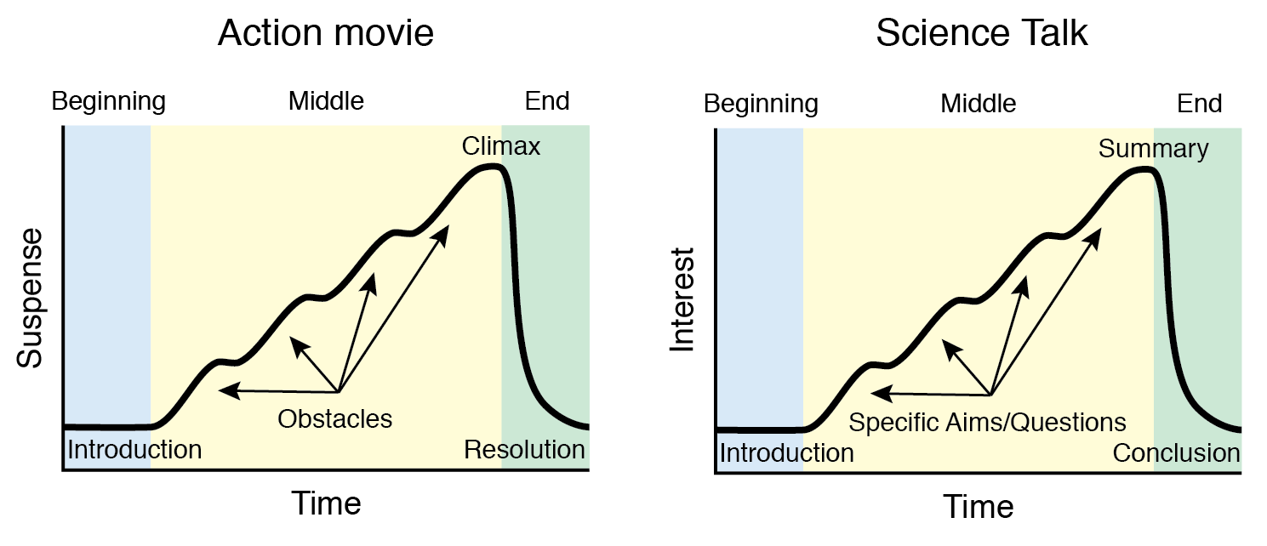
A good science talk is a good science story
A good scientific talk is just like any other good story, with a beginning, middle, and end
Notes:
A good scientific talk is just like any other good story, with a beginning, middle, and end. Good talks actually have a lot in common with good action movies… just as a protagonist overcomes obstacles through a series of action scenes, a scientist pursues scientific objectives through a series of experiments.

Slide 6
Start your talk with the big picture
Notes:
A good science talk starts with a general question and becomes progressively more and more specific until the speaker asks a unique scientific question.

Slide 7
End your talk with the big picture
Notes:
A good science talk ends by progressing from specific conclusions to more and more general statements, placing results in a broader context.

Slide 8
Inform your audience why they should care
Explain how your research may inform the treatment or etiology of a medical disorder
Describe how your research topic fascinated you as a kid
Convey the applicability of your research to real-world challenges
Explain that an aspect of the universe seems strange and mysterious, but the work you are describing is revealing a newfound understanding
Notes:
One of the worst questions that your audience can ask about your presentation is: “Why is this interesting?” Your audience might think you are smart and hard working, but if they don’t see any value in what you have accomplished or propose to accomplish scientifically, they will think you wasted your time (and theirs).
Instead, explain how your research may inform the treatment or etiology of a medical disorder. Describe how your research topic fascinated you as a kid and now you continue to feel like a kid because you get to study this topic as an adult. Convey the applicability of your research to real-world challenges. Explain that an aspect of the universe seems strange and mysterious, but the work you are describing is revealing a newfound understanding.
No matter what, ask yourself why you are interested in the subject in the first place and convey this passion to others.

Slide 9
Immediately state your question/goal
Notes:
Somewhere near the beginning of your presentation, clearly state your scientific research question and goal/hypothesis. Don’t hide this information at the bottom of a slide or on a slide with a lot of other text—call attention to it and make sure your audience knows it is a highly important aspect of your talk.

Slide 10
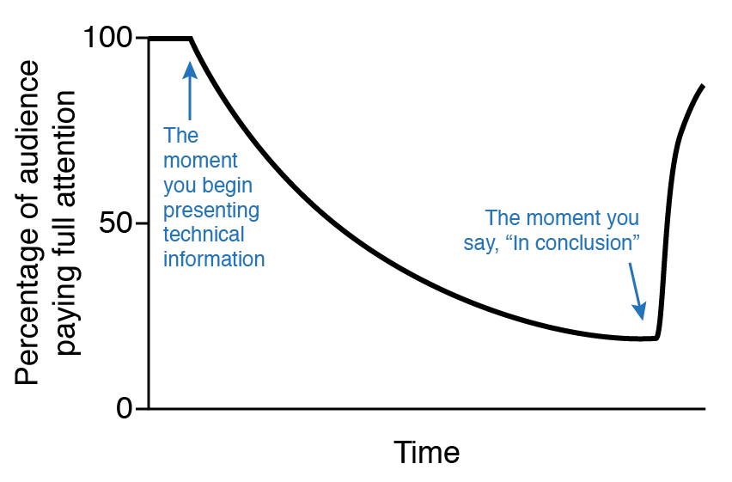
Break up detailed information into chunks
The percentage of your audience paying attention will steadily decrease over time
Occasionally “come up for air,” during your presentation summarizing what you have said and asking if there are any questions
Notes:
For longer talks, prepare for inevitable shifts in audience attention. The percentage of your audience paying attention will steadily decrease over time.
The biggest cause of audience in attention is long stretches of technical information. Instead of presenting information for too long, occasionally “come up for air,” summarizing what you have said and asking if there are any questions.

Slide 11
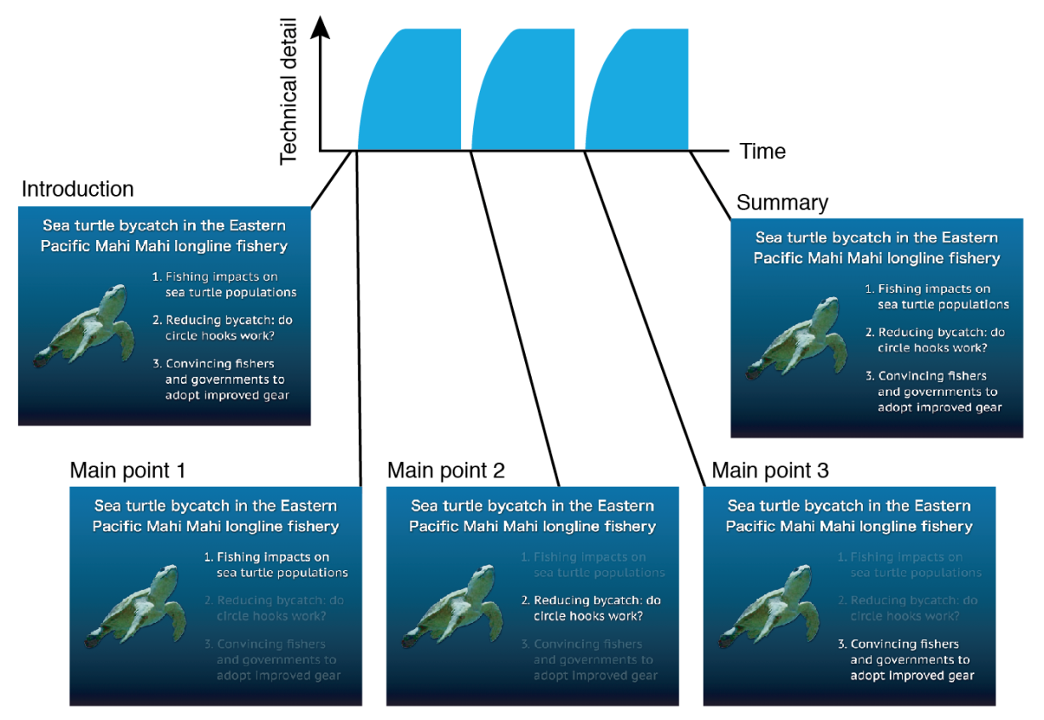
Unite sections of a talk using a “home slide”
Notes:
When dividing a presentation into manageable segments, it can be helpful to your audience to provide an outline that follows the structure of your talk and tracks your progress throughout. A good home slide contains an outline of the different sections of your talk with a picture or unifying diagram that represents the big picture.
Show this slide before you present your first segment of data and at the end of every section until the conclusion of your talk.

Slide 12
Tell a story for each result
For every result (e.g. graph, table, chart), narrate a brief rationale, statement of methods, explanation, and conclusion, like the examples below:
“Next, we wondered whether FOXO3 directly binds to the NPY promoter. To test this hypothesis, we used a chromatin immunoprecipitation assay. This assay involves using an antibody to bind to and purify a protein of interest (in this case, FOXO3), then uses PCR techniques to amplify any DNA that is bound to the protein. We found that the NPY promoter was indeed bound to FOXO3, supporting our hypothesis that FOXO3 binds and interacts with the NPY promoter.”
“Now that we know that FOXO3 binds to the NPY promoter, we wanted to determine whether FOXO3 could directly activate transcription of the NPY gene. To test this hypothesis, we used a luciferase assay. This assay is used to determine whether a transcription factor (in this case, FOXO3), activates transcription of a gene by using a bright yellow luciferase gene reporter. We found an increase in luciferase expression in conditions when FOXO3 was present compared to conditions when FOXO3 was absent , supporting our hypothesis that FOXO3 directly activates NPY transcription.”
Notes:
For every result (e.g. graph, table, chart), narrate a brief rationale, statement of methods, explanation, and conclusion. Don’t assume the audience instinctively knows what you are doing or which methods you are using. Every data graphic should be like it’s own mini science talk, with beginning, middle, and end.

Slide 13
Deliberately emphasize 1-3 take-home messages
Notes:
Choose the top aspects of your presentation that you want audiences to remember, and then deliberately highlight those items during your talk. Telling your audience what is important is incredibly helpful, and also makes your science resonate long after your talk is over.

Slide 14
End your talk with a summary diagram
Notes:
Most science talks end with a brief question-and-answer period. During this time, consider displaying a slide that contains a simple summary of your talk. This slide will help make your talk more memorable and also help your audience ask good questions because all the relevant information will be in front of them.

Slide 15
The three elements of a scientific presentation
Structure/narrative
2. Visual aids (slides)
3. Delivery of the presentation
Notes:
The following slides will discuss best practices for preparing a slide deck for your scientific presentation.

Slide 16
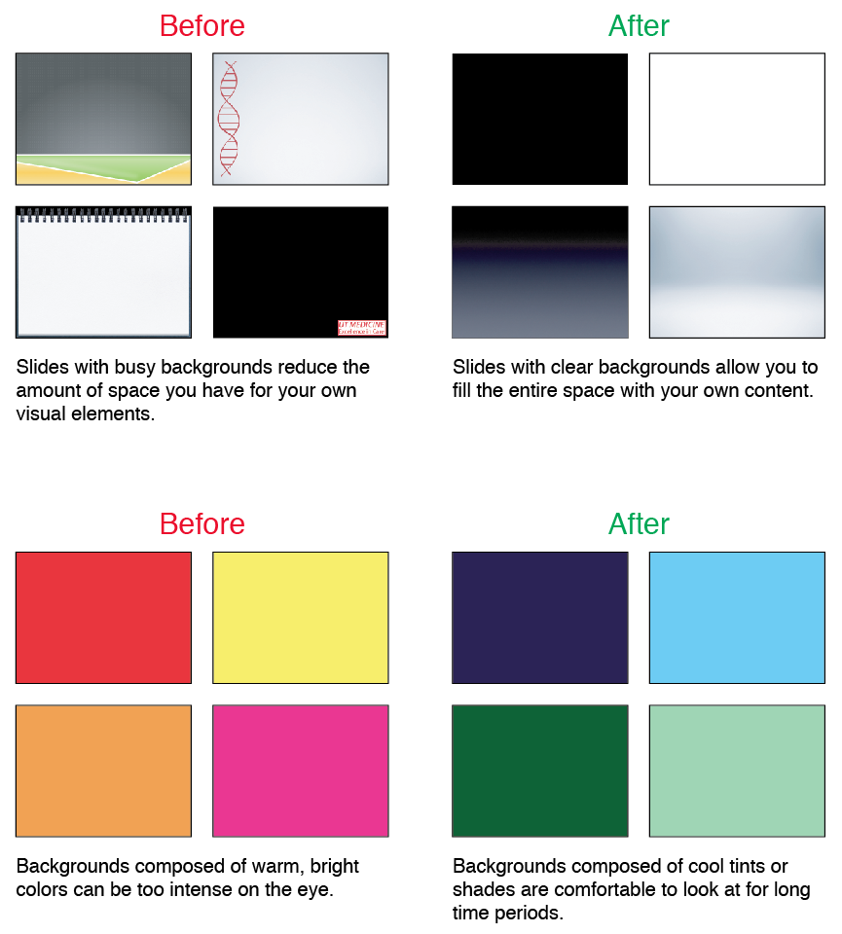
Choose slide backgrounds to optimize foreground content
Use backgrounds that lack visual content
Use a white slide background in a relatively small room (such as a small classroom)
Use a black slide background in a relatively large room (such as a large lecture room or presentation hall)
Notes:
The best backgrounds are simply that: backgrounds that, by themselves, lack visual content. Some human psychophysics studies show that it may be best to use a white slide background in a relatively small room (such as a small classroom) and use a black slide background in a relatively large room (such as a large lecture room or presentation hall).

Slide 17
Add design instead of decoration
X
Notes:
Don’t fill a slide with useless backgrounds or gimmicky clip art. Cute pictures may help fill a slide with “stuff,” but designing a slide to communicate with your audience adds meaning, value, and utility.

Slide 18
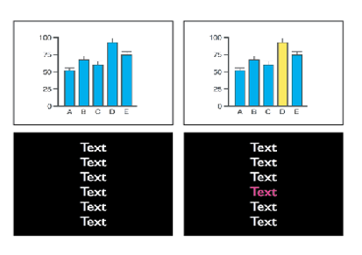
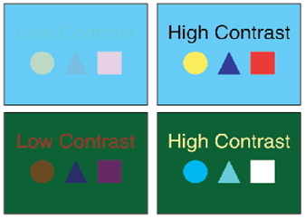
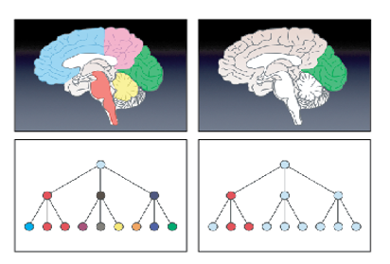
Use color wisely
Notes:
Ensure that everything on your slide is comfortable and easy to see. Use color to emphasize what is important.

Slide 19
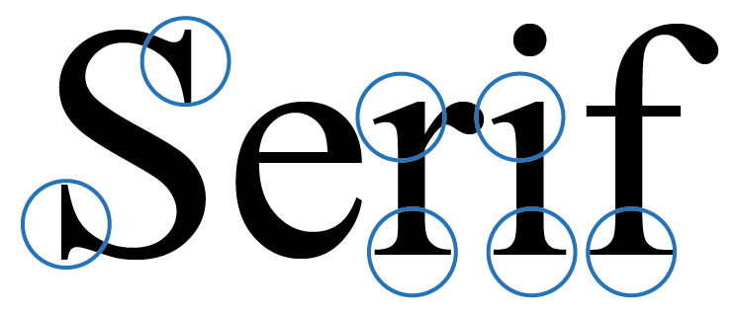
Use a sans serif font
Notes:
Serif fonts have slight projections that finish off the stroke of a letter. These projections can be helpful in a written document or a book.
A sans serif font that lacks these projections is easier to read on a slide projected onto a screen. Commonly used sans serif fonts include: Calibri, Century Gothic, Gill Sans, Helvetica, Myriad Pro, Tahoma, and Verdana

Slide 20
Ensure that all text is easy to read
Use 18-36 pts font to be seen in the back of the presentation room
Use smaller fonts for citations and footnotes
All text should be visible from back row

Slide 21
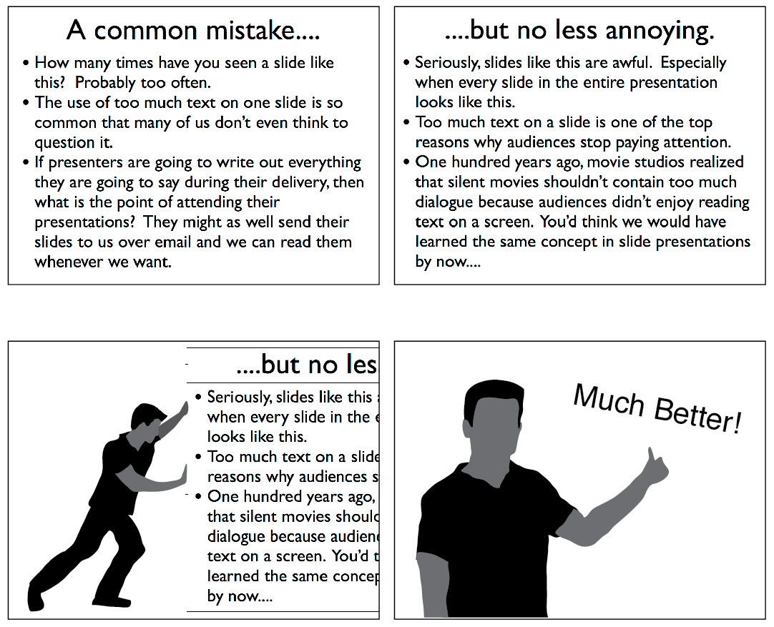
Keep text on a slide to an absolute minimum
Notes:
Probably the most common design problem in most slide presentations is adding too much text on one slide. If you find yourself filling up an entire slide with text, realize that you are not really creating a slide—you are creating a document.
Try to limit yourself to only two lines of text for any single title, bullet point, or statement on a slide. And limit the total amount of text to only about one-fourth the total area of the slide. If you can, give yourself the goal of including at least one image on every slide.

Slide 22
Use slide titles to make a point
Notes:
Don’t use slide titles for no reason—use them to emphasize a point or convey a message.
Example 1: Use a title to make a point, such as when presenting results, background information, ideas, etc.
Example 2: Don’t use generic words or phrases like “Background,” “Results,” or “Conclusions.” Instead, try to be specific about the larger point you want to emphasize.
Example 3: Don’t use a title when the contents of the slide are obvious and you don’t need to emphasize a point.

Slide 23
Try to make only one point per slide
Notes:
Audiences can only reflect meaningfully on one piece of information at a time. Therefore, try to only show one chart or figure per slide unless you have a good reason not to do so.
If you want to present two or more figures side by side for comparison or discussion, consider presenting them individually at first and then grouping them together afterwards.

Slide 24
Use the best photos/images for talks
Notes:
Photos are excellent for showing data and enhancing atmosphere and tone. Don’t feel compelled to make a photo a tiny aspect of a slide—make it as big and beautiful as your resolution allows. If the photograph is of a high enough quality, consider enlarging the photo to fill the entire slide to increase the impact.
If a photograph does not fill the entire screen, place it within a minimal frame so that it stands out from the background.
When presenting fluorescent images, use a dark background so that the fluorescent signal is the brightest aspect of the visual scene.

Slide 25
Use animation/slide transitions wisely
…..and sparingly
Notes:
Good design never calls attention to itself. Presentation effects should always be used in service of your science and not in service of the cool things you know how to do with your computer.

Slide 26
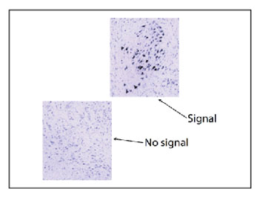
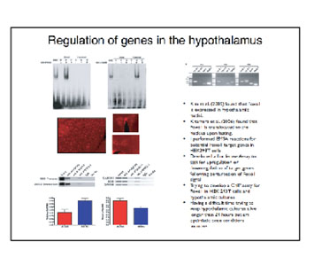
Strive for a simple slide layout
Slides that could use a good layout tune-up:
Too random and chaotic
Too busy and overwhelming
Too sparse and asymmetric (and a terrible use of a bullet)
Notes:
Arranging visual elements on a slide is much more consequential than simply making a slide “look nice.” Slide layout is about adding meaning to your content, controlling the flow of information to your audience, and emphasizing what is most important.

Slide 27
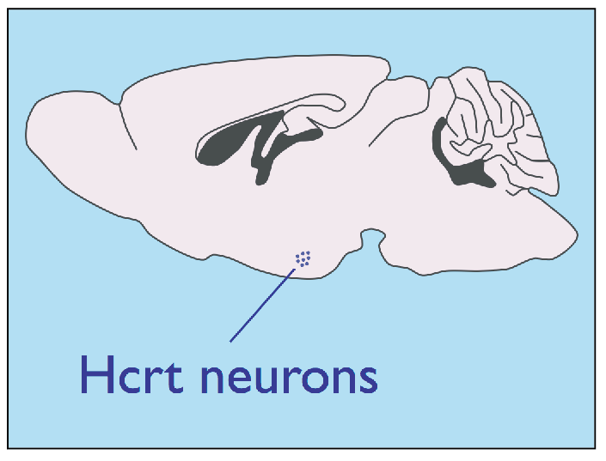
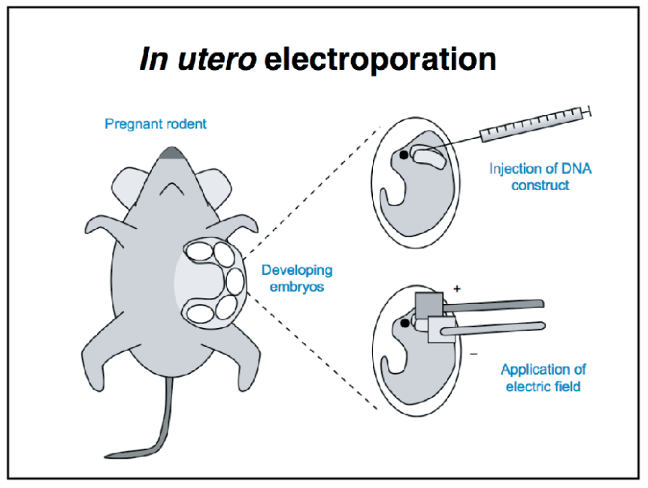
Produce the easiest-to-read slides as possible
The old maxim “less is more” truly holds for slides
Notes:
People new to making slide presentations often feel the need to fill their slides with too many visual elements. In reality, the old maxim “less is more” truly holds for slides.
Putting less content on a slide adds greater impact to the information that you choose to show, increasing the clarity of your message and simplicity of your delivery.

Slide 28
The three elements of a scientific presentation
Structure/narrative
2. Visual aids (slides)
3. Delivery of the presentation
Notes:
The following slides will focus on preparing to deliver your scientific presentation.

Slide 29
Rehearse and practice for a good delivery
Rehearse as much as possible
Deliver a mock presentation to an empty room while projecting slides on a screen
Rehearse mentally: at your desk, while riding your bicycle in the shower, etc.
Rehearse however you feel most comfortable, just try to rehearse so that you know exactly what you will say and, importantly, how long it will take you to say it
Notes:
Rehearse as much as possible. There is no such thing as a “natural” presenter. What distinguishes “naturals” from others is the degree to which they design and rehearse talks until they can communicate their message as effectively as possible.
Rehearsing means different things to different people. Some like to rehearse by actually delivering a mock presentation to an empty room while projecting slides on a screen. Others like to rehearse mentally: at their desks, while riding their bicycles, in the shower, etc. Rehearse however you feel most comfortable, just try to rehearse so that you know exactly what you will say and, importantly, how long it will take you to say it.

Slide 30
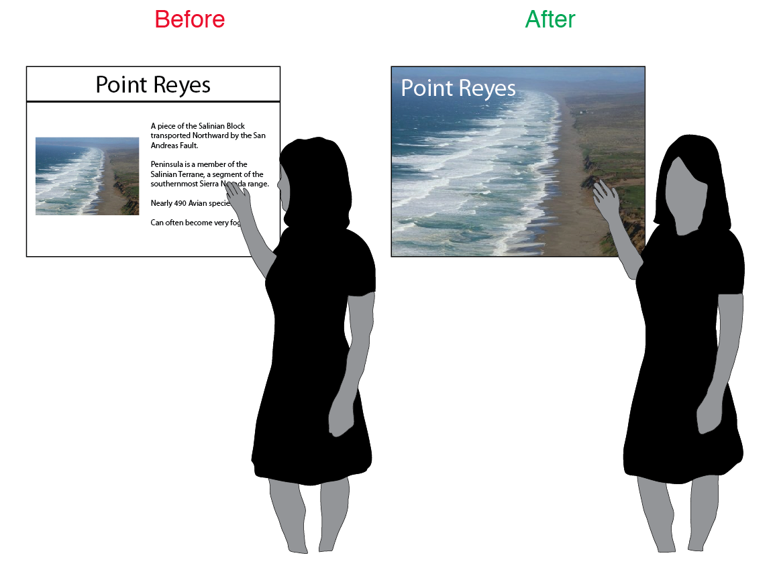
Don’t use slides as presentation notes
Notes:
Slides are for the audience, not the speaker.
Don’t design boring slides
Don’t look at the slides rather than making eye contact with your audience
Do be present and attentive to the real-time needs of your audience

Slide 31
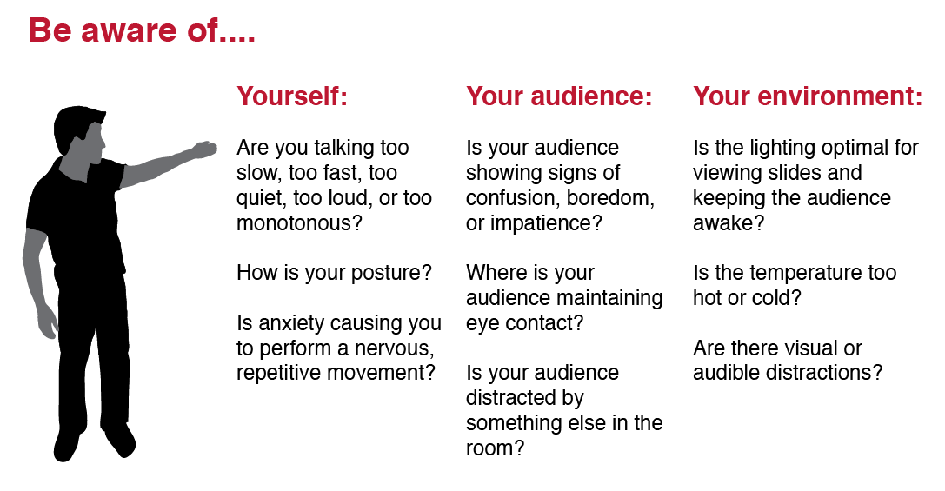
Try to “be present” as much as possible
Notes:
Being present as a speaker means having a clear understanding of yourself, your audience, and your environment during your real-time delivery. This skill takes practice, and you can always ask for feedback at the end of a talk to learn about how you came across to others.

Slide 32
Prepare for inevitable nerves and anxiety
Practice & preparation are key!
Some tricks:
Rehearse for the 5 min before your presentation begins
Memorize and rehearse the first 1-2 min of your talk most of all
Walk around your presentation space
Bring a water bottle
Notes:
Know that there is no correlation between how nervous a speaker is before or during a talk and how well he or she delivers a presentation. What distinguishes presenters who don’t seem nervous from presenters who let anxiety overcome their delivery is often practice and preparation. Some tricks:
Rehearse for the 5 min before your presentation begins. Speakers usually become most nervous just before their talks start, yet few scientists actively prepare for this time period. Anticipate the sights and sounds of the minutes before the start of your talk, especially the sounds of a gathering audience.
Memorize and rehearse the first 1-2 min of your talk most of all. Most speakers agree that once they get through the first minute of their presentation, anxiety begins to fade.
Walk around your presentation space. Although it is tempting to hide behind a presentation lectern, slowly walking around your available presentation space will not only help your audience pay attention to what you are saying, but will also help to calm your nerves and give you the perception that you are having a conversation with colleagues.
Bring a water bottle. Presentation anxiety can easily cause dry mouth. A quick drink every now and then can help you feel better physically.

Slide 33
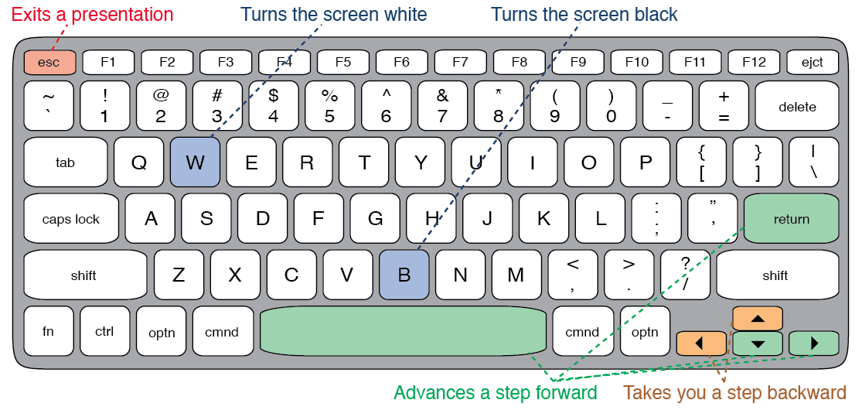
Practice using technology
Know how to use your keyboard to control your presentation including all shortcuts
Remember power cord and adapter
Determine how to dim or turn off lights if necessary
Bring a timer – phone or use presentation mode in PowerPoint
Bring a Laser Pointer for traditional screens
Use computer cursor for LED screens
Notes:
Know how to use your keyboard to control your presentation including all shortcuts. If your laptop requires its own power or projection cords (especially for Macs), make sure to bring them. If you anticipate needing to dim or turn off the lights, figure out how to do this before the talk begins. Make sure you have a way to keep track of time during the presentation so you can monitor how long your talk is taking.

Slide 34
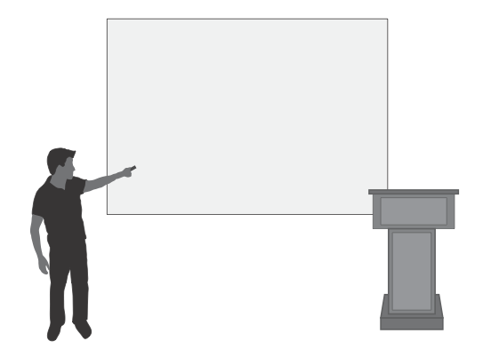
Practice using a laser pointer
Use a laser pointer sparingly:
Don’t turn on the laser pointer until it is aimed at the screen
Never aim a laser pointer in the direction of the audience
Don’t highlight text
Try to leave your pointer on for only a few seconds at most
Steady your hand if nervous and shaking
Consider purchasing a remote slide advancer with laser pointer
Notes:
Use a laser pointer sparingly. Just like any highlighting tool, the more you use it, the less your highlighted material stands out. on’t turn on the laser pointer until it is aimed at the screen, and never aim a laser pointer in the direction of the audience. Don’t highlight text, and try to leave your pointer on for only a few seconds at most. If you are nervous and you find your hand shaking, rest the hand holding the laser pointer on your other hand—this support will prevent your laser dot from nervously shaking around the screen.
Consider purchasing a remote slide advancer with laser pointer. These devices are inexpensive and allow you to move around your presentation space, simultaneously advancing slides and highlighting material with your laser pointer.

Slide 35
Soliciting and answering audience questions
Consider rephrasing the question in your own words before providing an answer
Prepare for difficult questions from the audience
Remain calm and project confidence
Don’t be afraid to say “I don’t know,” while speculating on an answer
Offer to talk with the questioner after the Q&A session is over
Notes:
After your talk is over, your final job is to solicit questions from the audience. After receiving a question, consider rephrasing the question in your own words before providing an answer. Doing so ensures that you correctly interpret the specific question that was asked, as well as making sure that everyone in the audience hears and understands the question.
Prepare for the possibility that you may face difficult questions from the audience, not necessarily because the questions are difficult to answer, but because of the nature of the questioners. No matter what, try to remain calm and project confidence. It is okay to say, “I don’t know,” while speculating on an answer. It is also okay to offer to talk with the questioner after the Q&A session is over.

Slide 36
Conclusion
Remember to have fun!
Remember that designing science talks is an art form, and there is no such thing as “the perfect talk”
The audience is on your side and wants you to do a great job
Each presentation you give is another evolution in your development as a presenter, and another experience to learn from for the future
Notes:
This presentation was intended to be an introduction to designing effective science presentations. As you work on presentations, remember to have fun!
One of the most fun aspects about designing and delivering science presentations is that your skills, attitude, and vision continuously evolve. Remember that designing science talks is an art form, and there is no such thing as “the perfect talk.” The audience is on your side and wants you to do a great job. Each presentation you give is another evolution in your development as a presenter, and another experience to learn from for the future.

